Slide 1
Chapter 2: The Microprocessor and its Architecture

Slide 2
Introduction
This chapter presents the microprocessor as a programmable device by first looking at its internal programming model and then how its memory space is addressed.
The architecture of Intel microprocessors is presented, as are the ways that the family members address the memory system.
Addressing modes for this powerful family of microprocessors are described for the real, protected, and flat modes of operation.

Slide 3
Chapter Objectives
Upon completion of this chapter, you will be able to:
Describe function and purpose of each program-visible register in the 8086-Core2 microprocessors, including 64-bit extensions.
Detail the flag register and the purpose of each flag bit.
Describe how memory is accessed using real mode memory-addressing techniques.

Slide 4
Chapter Objectives
(cont.)
Upon completion of this chapter, you will be able to:
Describe how memory is accessed using protected mode memory-addressing techniques.
Describe how memory is accessed using the 64-bit flat memory model.
Describe program-invisible registers found in the 80286 through Core2 microprocessors.
Detail the operation of the memory-paging mechanism.

Slide 5
2–1 INTERNAL MICROPROCESSOR ARCHITECTURE
Before a program is written or instruction investigated, internal configuration of the microprocessor must be known.
In a multiple core microprocessor each core contains the same programming model.
Each core runs a separate task or thread simultaneously.

Slide 6
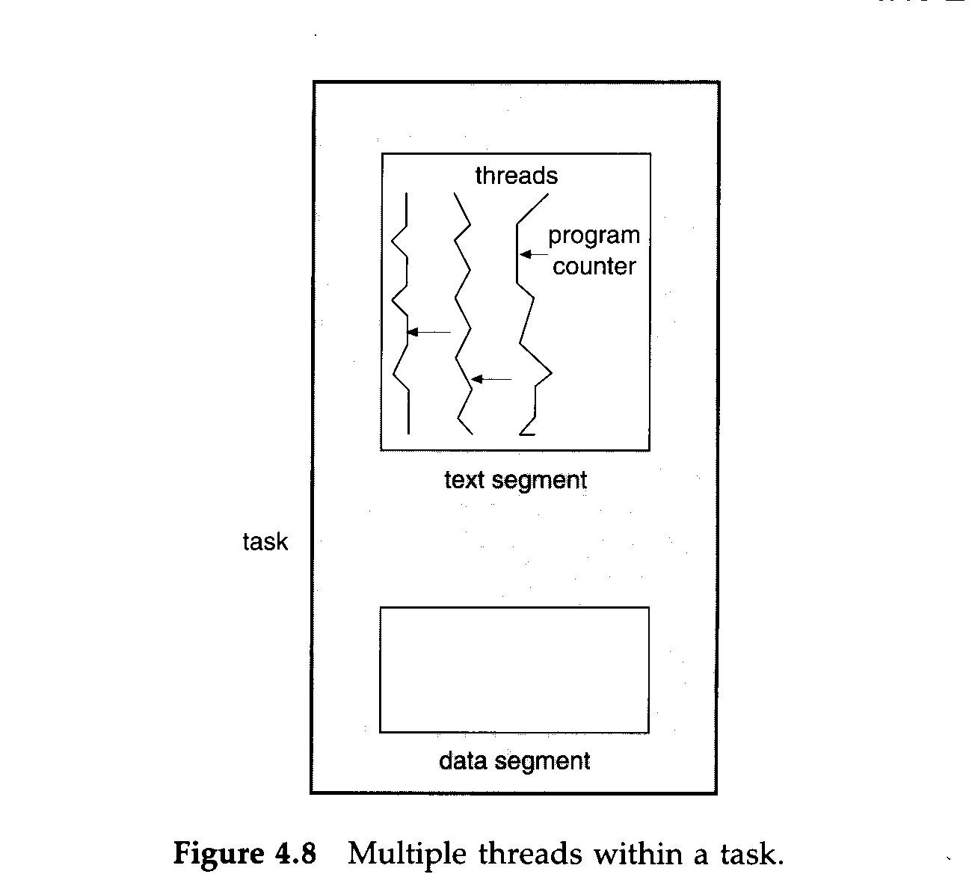
A thread consists of a program counter, a register set, and a stack space.
A task shares with peer threads its code section, data section, and operating system resources

Slide 7
The Programming Model
8086 through Core2 considered program visible.
  registers are used during programming and are specified by the instructions
Other registers considered to be program invisible.
  not addressable directly during applications programming

Slide 8
80286 and above contain program-invisible registers to control and operate protected memory.
  and other features of the microprocessor
80386 through Core2 microprocessors contain full 32-bit internal architectures.
8086 through the 80286 are fully upward-compatible to the 80386 through Core2.
Figure 2–1 illustrates the programming model 8086 through Core2 microprocessor.
  including the 64-bit extensions

Slide 9
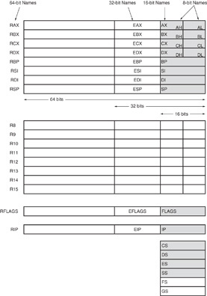
Figure 2–1 The programming model of the 8086 through the Core2 microprocessor including the 64-bit extensions.

Slide 10
Multipurpose Registers
RAX - a 64-bit register (RAX), a 32-bit register (accumulator) (EAX), a 16-bit register (AX), or as either of two 8-bit registers (AH and AL).
The accumulator is used for instructions such as multiplication, division, and some of the adjustment instructions.
Intel plans to expand the address bus to 52 bits to address 4P (2⁵²~10¹⁵ =peta) bytes of memory.

Slide 11
Address Space (Main Memory: RAM)
Address bus:16 bit →Address Space:64 KBytes
Address bus:20 bit →Address Space:1 MBytes Address bus:32 bit →Address Space:4 GBytes Address bus:34 bit →Address Space:16GBytes
Address bus:36 bit →Address Space:64GBytes
Address bus:38 bit →Address Space:256GBytes
Address bus:52 bit →Address Space:10¹⁵ Bytes

Slide 12
RBX, addressable as RBX, EBX, BX, BH, BL.
  BX register (base index) sometimes holds offset address of a location in the memory system in all versions of the microprocessor
RCX, as RCX, ECX, CX, CH, or CL.
  a (count) general-purpose register that also holds the count for various instructions
RDX, as RDX, EDX, DX, DH, or DL.
  a (data) general-purpose register
  holds a part of the result from a multiplication
  or part of dividend before a division

Slide 13
RBP, as RBP, EBP, or BP.
  points to a memory (base pointer) location
  for memory data transfers
RDI addressable as RDI, EDI, or DI.
  often addresses (destination index) string destination data for the string instructions
RSI used as RSI, ESI, or SI.
  the (source index) register addresses source string data for the string instructions
  like RDI, RSI also functions as a general-
  purpose register

Slide 14
R8 - R15 found in the Pentium 4 and Core2 if 64-bit extensions are enabled.
  data are addressed as 64-, 32-, 16-, or 8-bit
  sizes and are of general purpose
Most applications will not use these registers until 64-bit processors are common.
  the 8-bit portion is the rightmost 8-bit only
  bits 8 to 15 are not directly addressable as
  a byte

Slide 15
Special-Purpose Registers
Include RIP, RSP, and RFLAGS
  segment registers include CS, DS, ES, SS, FS, and GS
RIP addresses the next instruction in a section of memory.
  defined as (instruction pointer) a code segment
RSP addresses an area of memory called
the stack.
  the (stack pointer) stores data through this pointer

Slide 16
RFLAGS indicate the condition of the microprocessor and control its operation.
Figure 2–2 shows the flag registers of all versions of the microprocessor.
Flags are upward-compatible from the 8086/8088 through Core2 .
The rightmost five and the overflow flag are changed by most arithmetic and logic operations.
  although data transfers do not affect them

Slide 17
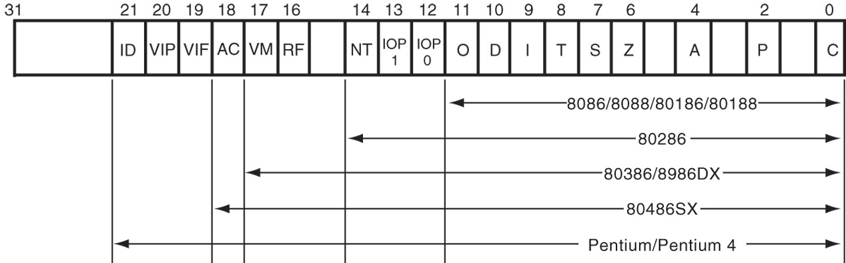
Figure 2–2 The EFLAG and FLAG register counts for the entire 8086 and Pentium microprocessor family.
Flags never change for any data transfer or program control operation.
Some of the flags are also used to control features found in the microprocessor.

Slide 18
Flag bits, with a brief description of function.
C (carry) holds the carry after addition or borrow after subtraction.
  also indicates error conditions
P (parity) is the count of ones in a number expressed as even or odd. Logic 0 for odd parity; logic 1 for even parity.
  if a number contains three binary one bits, it has odd parity
  if a number contains no one bits, it has even parity

Slide 19
List of Each Flag bit, with a brief description of function.
C (carry) holds the carry after addition or borrow after subtraction.
  also indicates error conditions
P (parity) is the count of ones in a number expressed as even or odd. Logic 0 for odd parity; logic 1 for even parity.
  if a number contains three binary one bits, it has odd parity; If a number contains no one bits, it
  has even parity

Slide 20
A (auxiliary carry) holds the carry (half-carry) after addition or the borrow after subtraction between bit positions 3 and 4 of the result.
Z (zero) shows that the result of an arithmetic or logic operation is zero.
S (sign) flag holds the arithmetic sign of the result after an arithmetic or logic instruction executes.
T (trap) The trap flag enables trapping through an on-chip debugging feature.

Slide 21
I (interrupt) controls operation of the INTR (interrupt request) input pin.
D (direction) selects increment or decrement mode for the DI and/or SI registers.
O (overflow) occurs when signed numbers are added or subtracted.
  an overflow indicates the result has exceeded
  the capacity of the machine

Slide 22
IOPL(Input/output Privilege Level) used in protected mode operation to select the privilege level for I/O devices.
NT (nested task) flag indicates the current task is nested within another task in protected mode operation.
RF (resume) used with debugging to control resumption of execution after the next instruction.
VM (virtual mode) flag bit selects virtual mode operation in a protected mode system.

Slide 23
AC(alignment check) flag bit activates if a word or doubleword is addressed on a non-word or non-doubleword boundary.
VIF is a copy of the interrupt flag bit available to the Pentium 4–(virtual interrupt)
VIP (virtual) provides information about a virtual mode interrupt for (interrupt pending) Pentium.
  used in multitasking environments to provide virtual interrupt flags

Slide 24
ID (identification) flag indicates that the Pentium microprocessors support the CPUID instruction.
  CPUID instruction provides the system with information about the Pentium microprocessor such as its version number and manufacturer.

Slide 25
Segment Registers
Generate memory addresses when combined with other registers in the microprocessor.
Four or six segment registers in various versions of the microprocessor.
A segment register functions differently in real mode than in protected mode.
Following is a list of each segment register, along with its function in the system.

Slide 26
CS (code) segment holds code (programs and procedures) used by the microprocessor.
DS (data) contains most data used by a program.
  Data are accessed by an offset address or contents of other registers that hold the offset address
ES (extra) an additional data segment used by some instructions to hold destination data.

Slide 27
SS (stack) defines the area of memory used for the stack.
  stack entry point is determined by the stack segment and stack pointer registers
  the BP register also addresses data within
  the stack segment

Slide 28
FS and GS segments are supplemental segment registers available in 80386–Core2 microprocessors.
  allow two additional memory segments for
  access by programs
Windows uses these segments for internal operations, but no definition of their usage
is available.

Slide 29
2–2 REAL MODE MEMORY ADDRESSING
80286 and above operate in either the real or protected mode.
Real mode operation allows addressing of only the first 1M byte of memory space—even in Pentium 4 or Core2 microprocessor.
  the first 1M byte of memory is called the real memory, conventional memory, or DOS memory system

Slide 30
Segments and Offsets
All real mode memory addresses must consist of a segment address plus an offset address.
  segment address defines the beginning address of any 64K-byte memory segment
  offset address selects any location within the
  64K byte memory segment
Figure 2–3 shows how the segment plus offset addressing scheme selects a memory location.

Slide 31
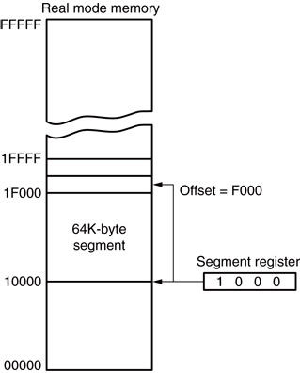
Figure 2–3 The real mode memory-addressing scheme, using a segment address plus an offset.
  this shows a memory segment beginning at 10000H, ending at location IFFFFH
    64K bytes in length
  also shows how an offset address, called a displacement, of F000H selects location
  1F000H in the memory

Slide 32
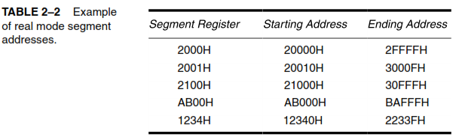
Real mode Segment Addresses
Memory address = (Segment Address X 10) + Offset

Slide 33
Once the beginning address is known, the ending address is found by adding FFFFH.
  because a real mode segment of memory is64K in length
The offset address is always added to the segment starting address to locate the data.
Segment and offset address is sometimes written as 1000:2000.
Suppose a segment address of 1000H; an offset of 246FH
➔ Now find the memory location.

Slide 34
Memory location = (Segment Address X 10) + Offset
= (1000 X 10)H + 246FH
= 10000H + 246FH
= 1246FH

Slide 35
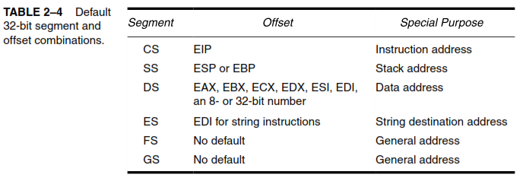
Default Segment and Offset Registers

Slide 36
Default Segment and Offset Registers
The microprocessor has rules that apply to segments whenever memory is addressed.
  these define the segment and offset register combination
The code segment register defines the start of the code segment.
The instruction pointer locates the next instruction within the code segment.

Slide 37
Another of the default combinations is the stack.
  stack data are referenced through the stack segment at the memory location addressed by either the stack pointer (SP/ESP) or the pointer (BP/EBP)
Figure 2–5 shows a system that contains four memory segments.
  a memory segment can touch or overlap if 64K bytes of memory are not required for a segment

Slide 38
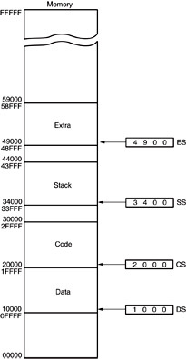
Figure 2–5 A memory system showing the placement of four memory segments.
  think of segments as Windows that can be moved over any area
  of memory to access data or code
  a program can have more than four or six segments,
    but only access four or six segments at a time

Slide 39
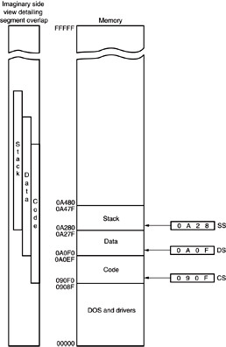
Figure 2–6 An application program containing a code, data, and stack segment loaded into a DOS system memory.
  a program placed in memory by DOS is loaded in the TPA at the first available area of memory above drivers and other TPA programs
  area is indicated by a free-pointer maintained by DOS
  program loading is handled automatically by the program loader within DOS

Slide 40
TPA
The transient program area (TPA) holds the DOS (disk operating system) operating system; other programs that control the computer system.

Slide 41
Segment and Offset Addressing Scheme Allows Relocation
Segment plus offset addressing allows DOS programs to be relocated in memory.
A relocatable program is one that can be placed into any area of memory and executed without change.
Relocatable data are data that can be placed in any area of memory and used without any change to the program.

Slide 42
Because memory is addressed within a segment by an offset address, the memory segment can be moved to any place in the memory system without changing any of the offset addresses.
Only the contents of the segment register must be changed to address the program
in the new area of memory.
Windows programs are written assuming that the first 2G of memory are available for code and data.

Slide 43
SUMMARY
The programming model of the 8086 through 80286 contains 8- and 16-bit registers.
The programming model of the 80386 and above contains 8-, 16-, and 32-bit extended registers as well as two additional 16-bit segment registers: FS and GS.

Slide 44
SUMMARY
(cont.)
8-bit registers are AH, AL, BH, BL, CH, CL, DH, and DL.
16-bit registers are AX, BX, CX, DX, SP, BP, DI, and SI.
The segment registers are CS, DS, ES, SS, FS, and GS.
32-bit extended registers are EAX, EBX, ECX, EDX, ESP, EBP, EDI, and ESI.

Slide 45
SUMMARY
(cont.)
The 64-bit registers in a Pentium 4 with 64-bit extensions are RAX, RBX, RCX, RDX, RSP, RBP, RDI, RSI, and R8 through R15.
In addition, the microprocessor contains an instruction pointer (IP/EIP/RIP) and flag register (FLAGS, EFLAGS, or RFLAGS).
All real mode memory addresses are a combination of a segment address plus an offset address.

Slide 46
SUMMARY
(cont.)
The starting location of a segment is defined by the 16-bit number in the segment register that is appended with a hexadecimal zero at its rightmost end.
The offset address is a 16-bit number added to the 20-bit segment address to form the real mode memory address.
All instructions (code) are accessed by the combination of CS (segment address) plus IP or EIP (offset address).

Slide 47
SUMMARY
(cont.)
Data are normally referenced through a combination of the DS (data segment) and either an offset address or the contents of a register that contains the offset address.
The 8086-Core2 use BX, DI, and SI as default offset registers for data if 16-bit registers are selected.
The 80386 and above can use the 32-bit registers EAX, EBX, ECX, EDX, EDI, and ESI as default offset registers for data.

Slide 48

Thank You All……
See you in next class……

